Slide 1

A Machine Learning Based Approach For CO2 Emission Rating Of Vechicles Using Data Science
Under the guidance of: Presented By:
G. Srikanth Batch A8
Assistant Professor K. Ramya 21271A0533
CSE Department K. Roshini 21271A0536
P. Sai vinod 21271A0544
K. Sai Rahul 21271A0539

Slide 2
AGENDA
Abstract
Introduction
Literature Survey
Problem Statement
Existing System and Proposed System
System Requirements
System Design
Coding and Implementation
Result Analysis
Conclusion

Slide 3
ABSTRACT
The project A Machine Learning Based Approach for CO2 Emission Rating of Vehicles Using Data Science focuses on analyzing CO2 emissions of new light-duty vehicles in Canada for 2022.It uses Python programming and a machine learning model called Random Forest Classifier.The model helps in predicting and rating vehicles based on their carbon emissions.This makes it easier to understand which vehicles are more eco-friendly.The project provides useful insights for both consumers and policymakers.It helps people make better choices when buying vehicles.By encouraging the use of low-emission vehicles, it supports cleaner transportation.Overall, the project aims to reduce pollution and protect the environment.

Slide 4
INTRODUCTION
With the rising concerns over climate change and environmental degradation, reducing greenhouse gas emissions has become a global priority.
The transportation sector is one of the major contributors to CO2 emissions, particularly through the use of gasoline and diesel-powered vehicles.
As more data becomes available, applying data science and machine learning offers a powerful way to assess and address these emissions.
Machine learning models can uncover patterns in vehicle performance and environmental impact that may not be immediately visible through traditional analysis.
By leveraging historical data, these models can predict emission levels and guide the development of cleaner technologies.
These tools are helpful not just for researchers and developers, but also for consumers who want to make environmentally friendly choices.

Slide 5
LITERATURE SURVEY
Rapid Assessments of Light-Duty Gasoline Vehicle Emissions Using On-Road Remote Sensing and Machine Learning
Published Year : 2021
Authors : L. M. Alavi, H. W. L. Tse, M. F. K. Bo
This paper develops a method to quickly assess emissions from light-duty gasoline vehicles using on-road remote sensing technology combined with machine learning.
The approach collects real-time emission data, such as nitrogen oxides, carbon monoxide, and hydrocarbons, from vehicles on the road without requiring direct inspections.
Machine learning algorithms are used to analyze this data and predict emissions accurately, enabling the identification of high-emitting vehicles.

Slide 6
LITERATURE SURVEY
Reducing Vehicle Emissions Using Deep Learning Techniques
Published Year : 2022
Authors: Madhusree Saha, Ravi P. Agarwal.
This paper applies deep learning techniques to predict and reduce vehicle emissions.
The authors use a combination of convolutional neural networks (CNN) and long short-term memory (LSTM) networks to develop a robust model for emission prediction.
The study focuses on how deep learning can improve emission forecasting accuracy by handling large-scale vehicle and environmental data.

Slide 7
LITERATURE SURVEY
CO₂ Emission Rating Using Regression Models and Machine Learning
Published Year : 2023
Authors: M. Salih and R. Zeeshan.
This paper investigates the use of regression models and machine learning to rate CO₂ emissions in different types of vehicles.
It introduces a novel hybrid regression model that combines traditional linear regression with random forest predictions to achieve a more robust and reliable emission rating system.
The model is applied to a diverse dataset of passenger cars and trucks.

Slide 8
LITERATURE SURVEY
S.NO | TITLE | AUTHOR’S NAME | YEAR
1 | Rapid Assessments of Light-Duty Gasoline Vehicle Emissions Using On-Road Remote Sensing and Machine Learning | L.M.Alavi , H.W.L.Tse,M.F.KBo | 2021
2 | Reducing Vechicle Emissions Using Deep Learning Techniques. | Madhusree Saha, Ravi P.Agarwal | 2022
3 | CO2 Emission Rating Using Regression Models and Machine Learning. | M.Salih and R.Zeeshan | 2023

Slide 9
PROBLEM STATEMENT
The environment suffers from pollution, it’s important for consumers to understand vehicle emissions.
There is a lack of accessible tools to evaluate the environmental impact of vehicles.
Many regions still lack strong enough incentives (financial or otherwise) to encourage consumers to purchase low-emission or zero-emission vehicles.
The rising levels of air pollution from vehicle emissions are directly linked to health problems, particularly in urban areas, creating an urgent need for solutions to reduce vehicular pollution.

Slide 10
EXISTING SYSTEM
The project used a Decision Tree Classifier to assess and rate CO2 emissions of light-duty vehicles sold in Canada in 2022.
The Decision Tree algorithm was chosen for its simplicity and interpretability, making it easy to understand.
The model categorized vehicles based on their CO2 emissions, providing an environmental impact rating.
The Decision Tree split the data into branches based on these features, using a series of rules to predict each vehicle’s CO2 rating.
They may struggle to capture complex patterns in the data, limiting predictive performance.
The model can be unstable, as small changes in data might lead to very different decision trees.
.

Slide 11
Disadvantages of Existing System
Overfitting.
Lack of Robustness.
Limited Handling of continous variables.
Difficulty in representing complex relationship.
No_out_of_the _Box handling of missing data.
Limited support for regression.
Not ideal for imbalanced data.

Slide 12
PROPOSED SYSTEM :
The proposed system for "A Machine Learning Based Approach For CO2 Emission Rating by Vehicles Using Data Science" seeks to enhance the existing framework by incorporating advanced data science techniques and algorithms to address some of the limitations observed in the previous system.
The proposed system introduces several improvements to provide more accurate and robust CO2 emissions ratings for vehicles.
In the proposed system, an ensemble learning approach is adopted, utilizing the Random Forest Classifier. This ensemble method combines multiple Decision Trees to reduce overfitting and enhance the overall predictive performance.
To address the issue of missing data, the proposed system implements robust strategies for data imputation. By handling missing values effectively, the system aims to minimize the impact of incomplete information on the CO2 emissions ratings.

Slide 13
Advantages of Proposed System
Improved Accuracy.
Robustness to Noise.
Enhanched Generalization.
Reduced Sensitivity to data variation.
Transparency.
Continuous monitoring and updates.
Reduced Bias.

Slide 14
SYSTEM REQUIREMENTS
HARDWARE REQUIREMENTS :
System : intel i5 or higher.
RAM : Minimum 8 GB.
Storage : SSD with at least 256GB
(preferably 500GB or more)

Slide 15
SOFTWARE REQUIREMENTS
Operating System : Windows 10 or 11 .
Frontend : HTML/CSS, JavaScript.
Backend : Python, Flask.
Libraries : Pandas&NumPy, Scikit-learn, Joblib/Pickle
DataBase : MySQL

Slide 16
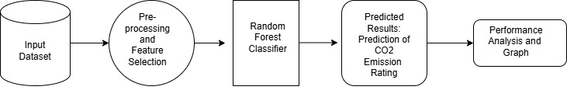
SYSTEM DESIGN SYSTEM ARCHITECHTURE :

Slide 17
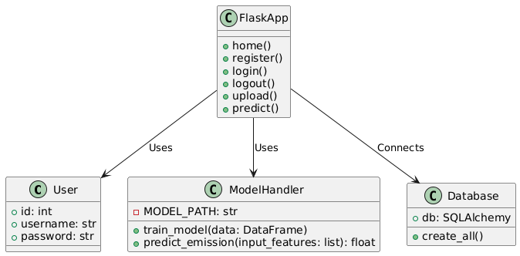
UML DIAGRAMS CLASS DIAGRAM

Slide 18
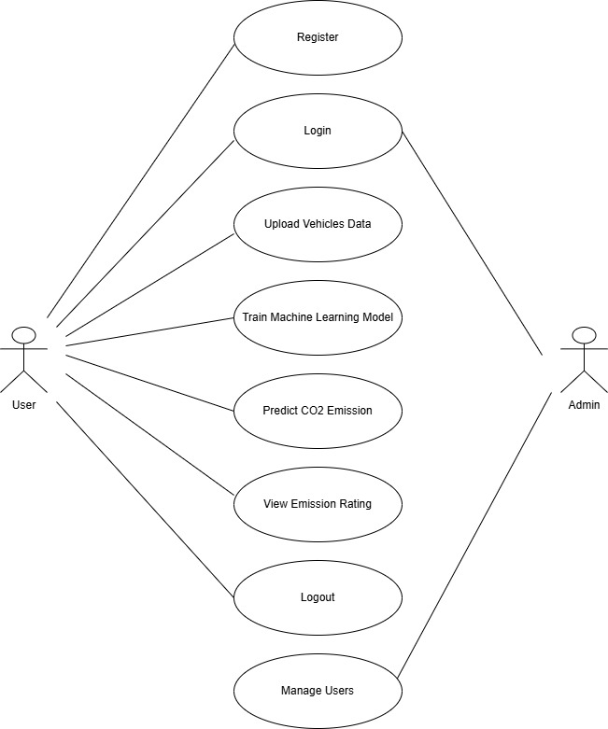
USECASE DIAGRAM

Slide 19
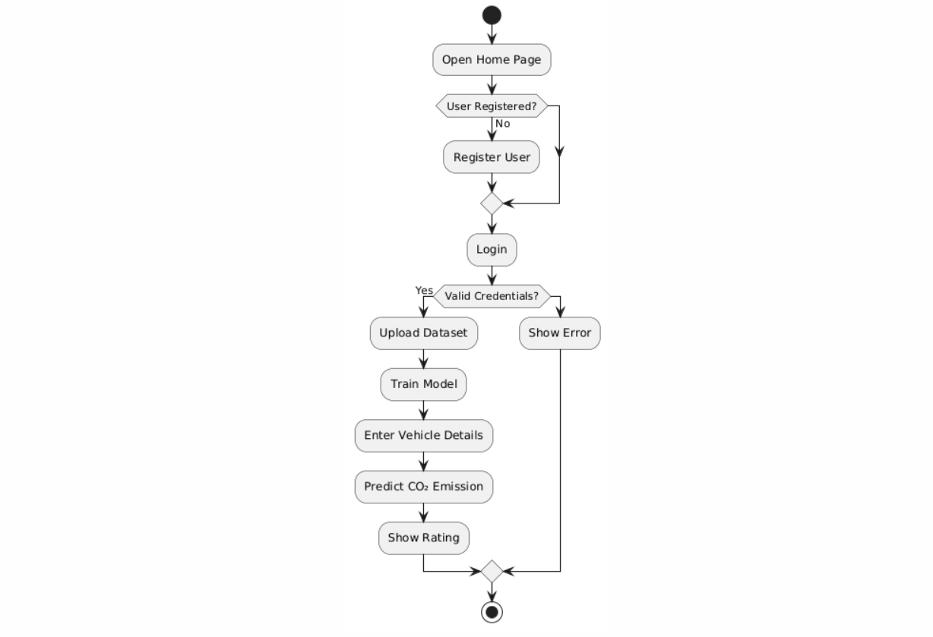
ACTIVITY DIAGRAM

Slide 20
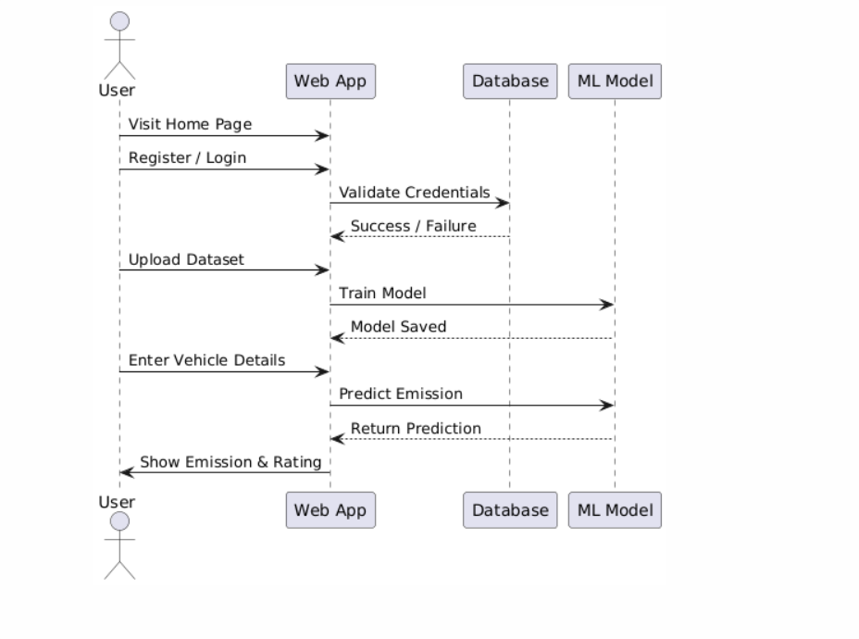
SEQUENCE DIAGRAM

Slide 21
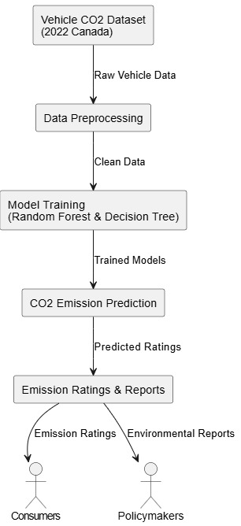
DATA FLOW DIAGRAM

Slide 22
CODING & IMPLEMENTATION
Flask Application Setup.
User Management and Authentication.
Data Upload and Model Training.
Predicting CO₂ Emissions.
HTML Interface and Frontend Templates.
Validation and Error Reporting.
Launching the Application.

Slide 23
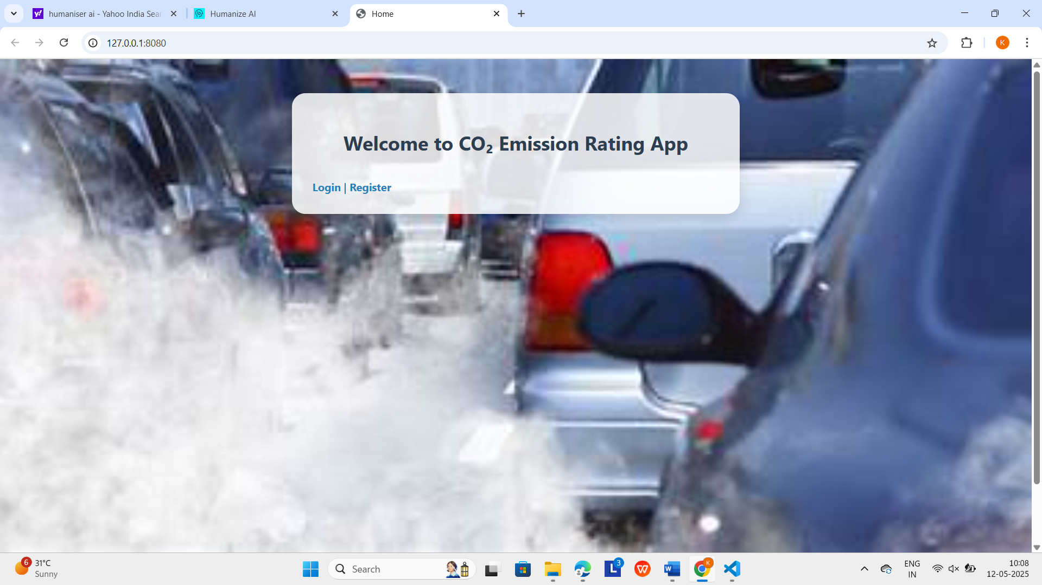
RESULTS
The Home page of the CO₂ Emission Rating App, this screen provides users with clear Login and Register options to access the application.

Slide 24

The Register page allows users to create an account by entering a username and password.

Slide 25
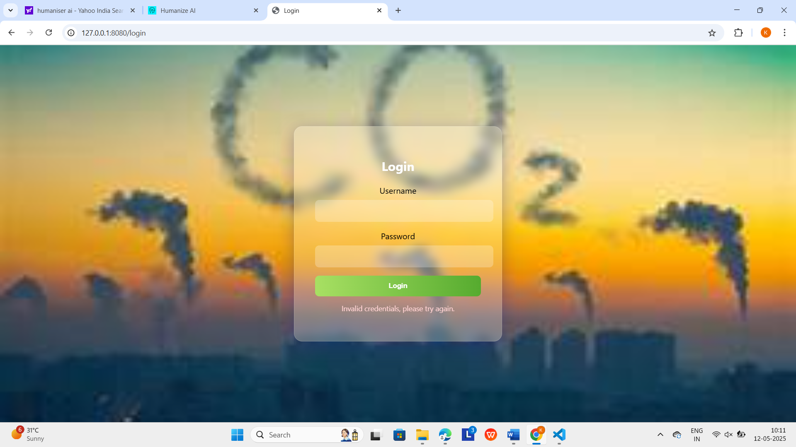
In this Login page Users are prompted to enter their credentials, and an error message appears for invalid login attempts.

Slide 26

The Upload Vehicle Data page lets users upload a CSV file and start training the model with a green Upload and Train Model button.

Slide 27
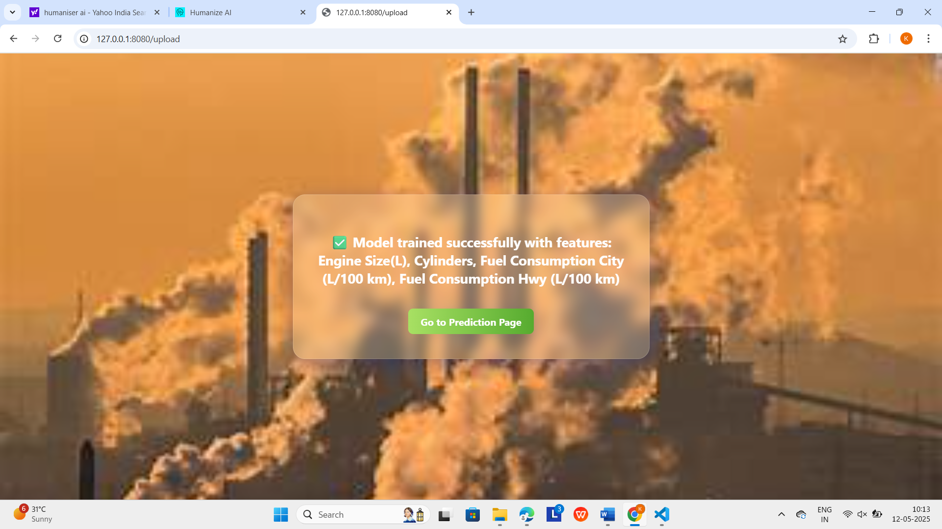
The confirmation screen shows successful model training using features like engine size, cylinders, and fuel consumption, with a green "Go to Prediction Page" button to proceed.

Slide 28
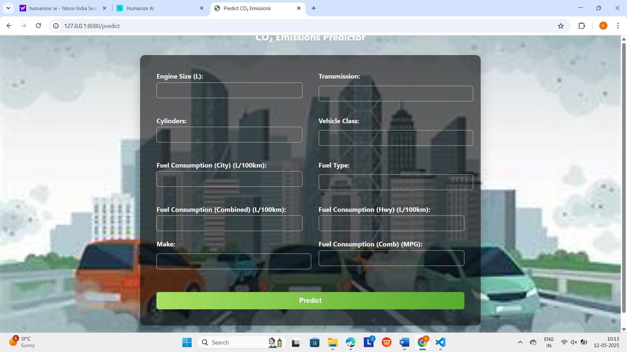
In this prediction page, where users input various vehicle parameters such as engine size, fuel consumption, and vehicle class. Upon entering the data, the Predict button estimates the CO₂ emissions based on the trained machine learning model.

Slide 29
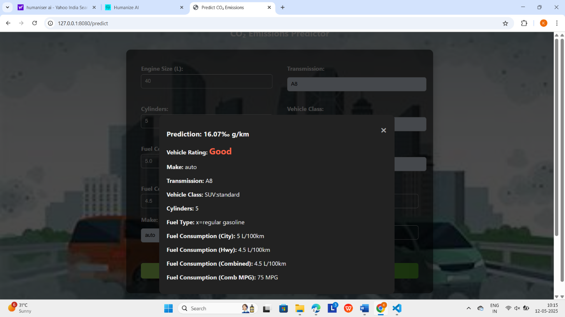
Finally, it predict vehicles rating as good or average or bad based on the input provided by the user.

Slide 30
CONCLUSION
This project shows how machine learning can help analyze vehicle CO2 emissions.
It uses data to predict which vehicles produce less pollution.
This information helps people and decision-makers choose cleaner cars.
By doing this, the project supports using vehicles that are better for the environment.
It also shows how technology can help solve environmental problems.
Since vehicle emissions cause pollution, this work is very important.
Overall, the project helps protect the environment and encourages a greener future.

Slide 31
THANK YOU

